Slide 1
THEORETICAL IDEAS IN NONEQUILIBRIUM STATISTICAL MECHANICS
Marco Uguccioni Master’s Degree in Theoretical Physics Physics of Complex Systems 2020/2021 Prof. Armando Bazzani

Slide 2
AIM OF THE WORK
Approach to NONEQUILIBRIUM STATISTICAL MECHANICS taking into account the CHAOTIC character of microscopic dynamics:
NONEQUILIBRIUM STEADY SYATES SRB MEASURES
GALLAVOTTI-COHEN FLUCTUATION THEOREM
Near equilibrium:
ONSAGER RECIPROCITY RELATIONS
FLUCTUATION-DISSIPATION THEOREM
-Classical results
-No Thermodynamic limit

Slide 3
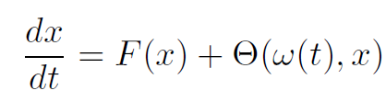
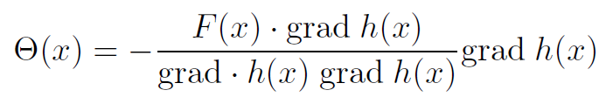

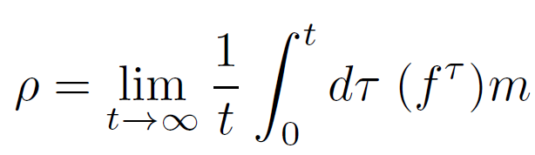
THERMOSTATS AND N.E.S.S.
Non-Hamiltonian forces + effect of thermostat
Gaussian thermostat
Given a probability measure m in the phase space with f^{t} time evolution operator, then we have natural N.E.S.S. defined by the f^{t} –invariant measures:

Slide 4

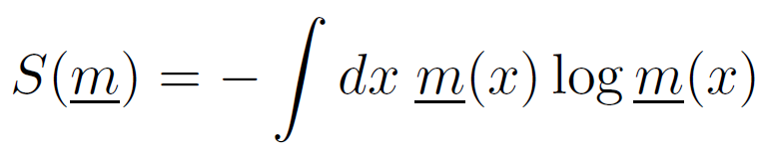

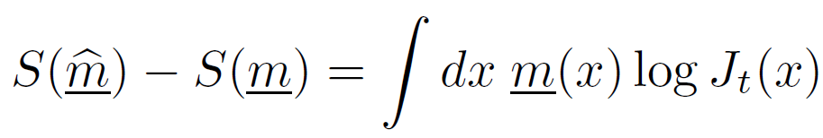

ENTROPY PRODUCTION
GIBBS ENTROPY
Entropy production per unit of time (J=J₁) in the N.E.S.S.
Jacobian determinant

Slide 5
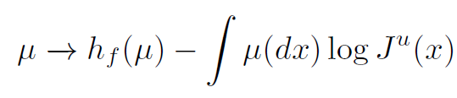
SRB MEASURES (I)
SRB measures are ergodic just on an initial set of positive Lebesgue measure. We want to identify the N.E.S.S. with the SRB measures in presence of Gaussian thermostat.
Assume the UNIFORM HYPERBOLICITY (strong chaoticity) and that time evolution happens on AXIOM A ATTRACTORS (hyperbolicity on an finite union of disjoint attractors).
SRB measures maximize (0):
Sinai-Kolmogorov Entropy
Expanding Jacobian

Slide 6
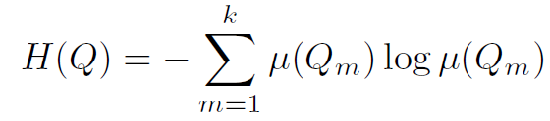

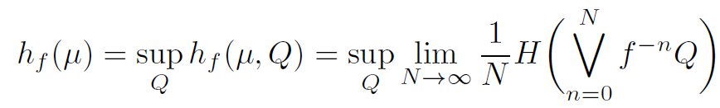

SRB MEASURES (II)
SINAI-KOLMOGOROV ENTROPY: mean information production per time by the system. Let f=f¹ be the time-1 map for the dynamical system and µ an f-invariant measure.
Partition
Entropy of a partition
Refinement
f-pullback

Slide 7


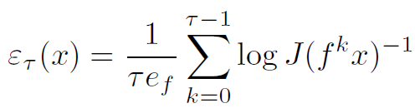


GALLAVOTTI-COHEN THEOREM (I)
Assume REVERSIBILITY
Dimensionless entropy production rate at x over a time τ with
Fluctuations of this entropy: exists p*>0 such that if |p|<p* and δ>0 we have

Slide 8
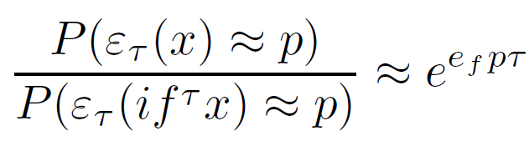
GALLAVOTTI-COHEN THEOREM (II)
Physical meaning: there exist a probability that the entropy for a finite system out of equilibrium will flow in a direction opposite to that dictate by the 2nd LAW OF THERMODYNAMICS.
But is NOT A VIOLATION! In the TD Limit (macroscopic systems) or waiting a sufficient long time this result coincide with the 2nd law.

Slide 9
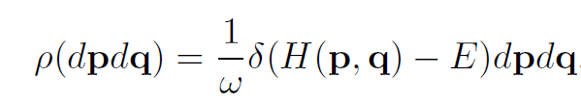

NONEQUILIBRIUM NEAR EQUILIBRIUM
From now on we place ourself close to equilibrium.
Isolated system at equilibrium MICROCANONICAL ENSEMBLE
We can assume ρ to be ergodic (ergodic hypotesis) and notice that ρ is an SRB state.
Hamilton’s Equations

Slide 10

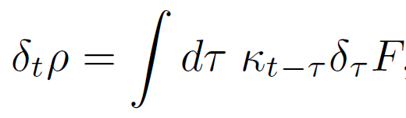
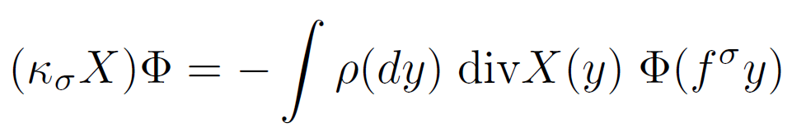


LINEAR RESPONSE
We want to know the linear response of an equilibrium SRB state to time dependent perturbation
where κ is the RESPONSE FUNCTION
SUSCEPTIBILITY
Time dependent entropy production
(no dependence on the quadratic response)

Slide 11

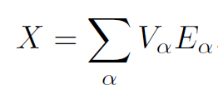
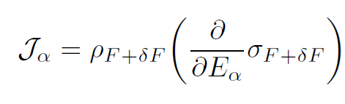

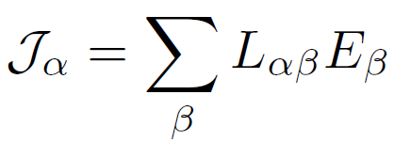
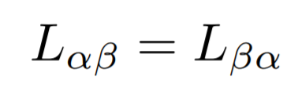
ONSAGER RELATIONS
Assume REVERSIBILITY. Consider a time independent force pushing the system away from eq. and an evolution that depends smoothly on some parameters E_{α}
Thermodynamic Forces E_{α}
Thermodynamic Flux J_{α}
local entropy production

Slide 12



FLUCTUATION-DISSIPATION THEOREM
Assume REVERSIBILITY. Relation between fluctuations in a system and the response of the system to applied perturbation (see BROWNIAN MOTION).
Dissipation
Fluctuations
Real part of the susceptibility corresponding to the force X is
the Fourier Transform of the time correlation function for the equilibrium state
TIME CORRELATION FUNCTION
SPECTRAL
DENSITY

Slide 13
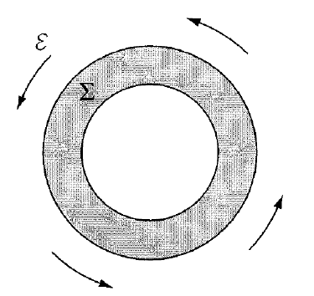
CONCLUSIONS
We obtained and recovered correctly important results of nonequilibrium statistical mechanics under the hypotesis of strong chaoticity (using SRB states).
A physical example of non-Hamiltonian system with Gaussian thermostat: system of classical particles on a torus thermostatted fixing the kinetic energy, subjected to electric multivalued potential that change by a constant after one turn.
THERMODYNAMIC LIMIT for a macroscopic system the extensive variables fluctuate very little. But in a N.E.S.S. this is not generally true (counterexample: TURBOLENCE).

Slide 14
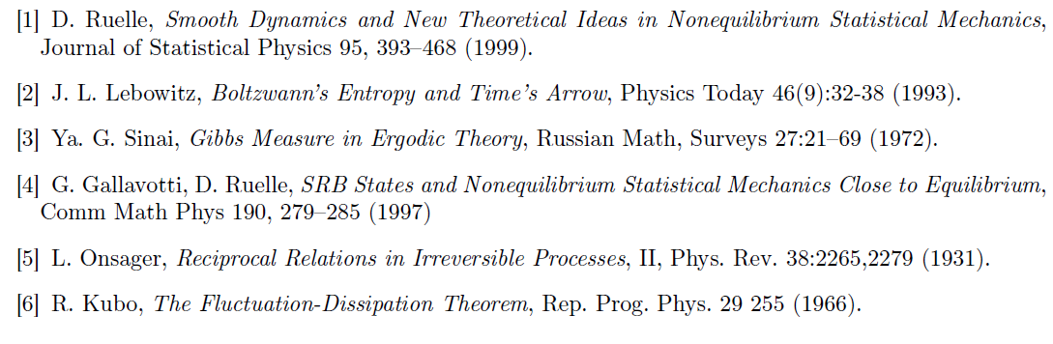
REFERENCES

Slide 15
THANKS FOR YOUR ATTENTION!

